Slide 1



UK Quantum
Hackathon 2024
#UKQHack24
NHS Forecasating
Trust me, I'm a Doctor
… of physics
… in training
NHS England
Classiq, IonQ, AWS Braket
UK Quantum Hackathon 2024
Notes:
Freddie

Slide 2
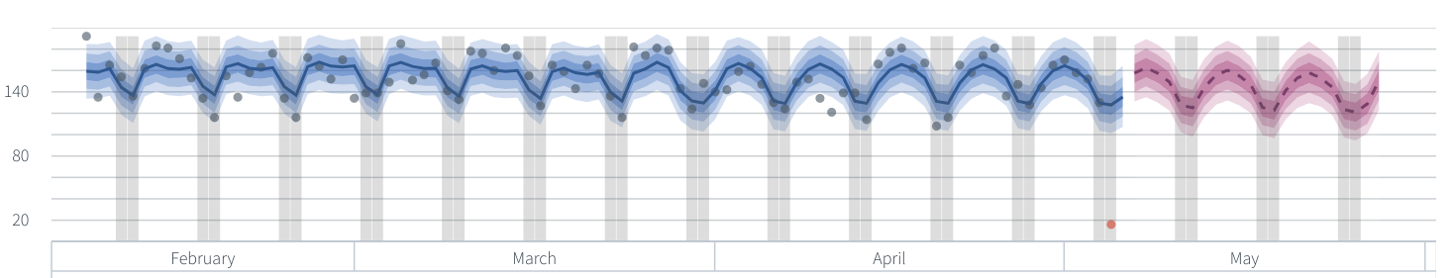

Problem Description
NHS has a three-week forecast of A&E admissions
Train model by fitting to past data
Complex modelling is computationally expensive
UK Quantum Hackathon 2024
References: https://nhsengland.github.io/datascience/our_work/a_and_e_forecasting_tool/
Notes:
Freddie

Slide 3
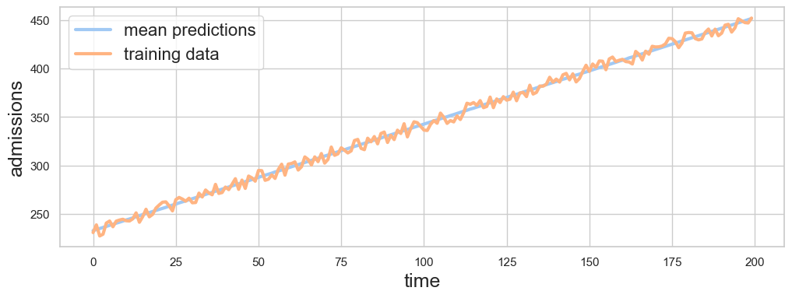
Simplify the Problem
Model admissions as a noisy linear trend.
Fit two parameters, gradient and y-intercept.
Currently, NHS uses MCMC to probability distributions for the fit parameters.
UK Quantum Hackathon 2024
References: https://nhsengland.github.io/datascience/our_work/a_and_e_forecasting_tool/
Notes:
Freddie

Slide 4
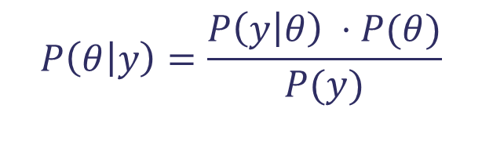
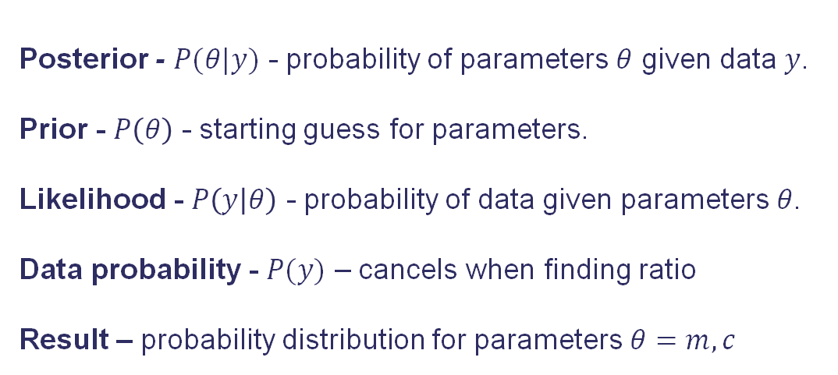
Bayesian Modelling
Posterior - $P(θ|y)$ - probability of parameters $θ$ given data $y$.
Prior - $P\left(θ\right)$ - starting guess for parameters.
Likelihood - $P\left(y | θ\right)$ - probability of data given parameters $θ$.
Data probability - $P(y)$ – cancels when finding ratio
Result – probability distribution for parameters $θ=m, c$
Bayes’ formula
$$P\left(θ | y\right)=\frac{P\left(y | θ\right) ⋅P(θ)}{P(y)}$$
UK Quantum Hackathon 2024
References: https://nhsengland.github.io/datascience/our_work/a_and_e_forecasting_tool/
Notes:
Freddie

Slide 5
Parameter Walk
admissions
y-intercept
time
gradient
Notes:
Freddie

Slide 6
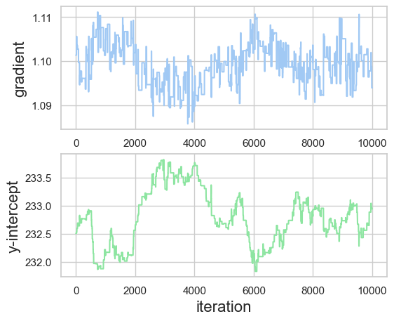
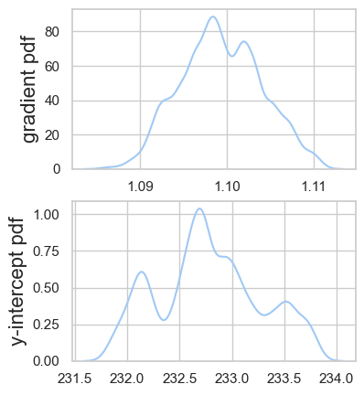
Not Feasible In Quantum
Path to PDF
Notes:
Freddie

Slide 7

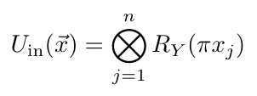



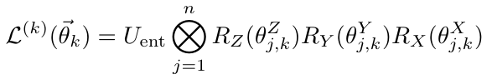


Problem Formulation – Quantum Machine Learning
Time series data
Embed in quantum state with feature map ,
Quantum “neural network” with operators
Measure
Repeat!
Loss function
UK Quantum Hackathon 2024
References: Time Series Forecasting with Quantum Machine Learning Architectures
www.researchgate.net/publication/364624751_Time_Series_Forecasting_with_Quantum_Machine_Learning_Architectures
Notes:
Uddhav

Slide 8
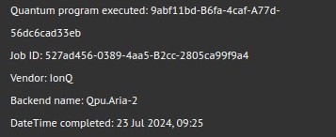
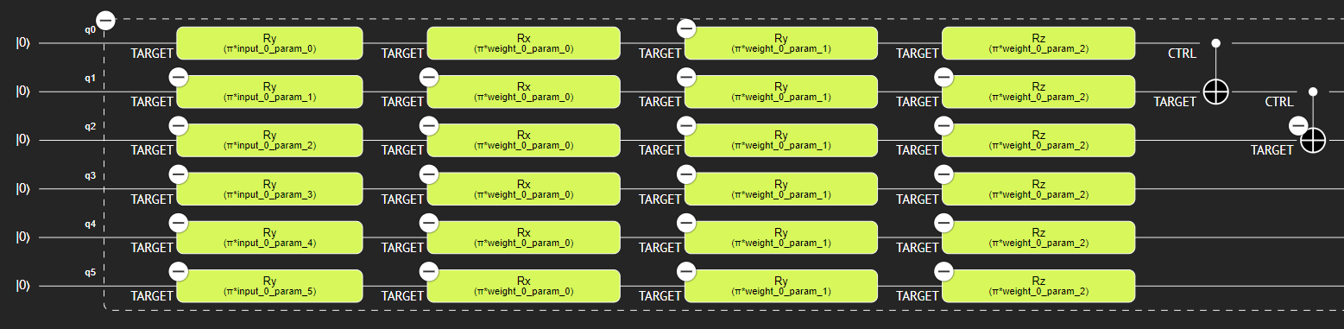
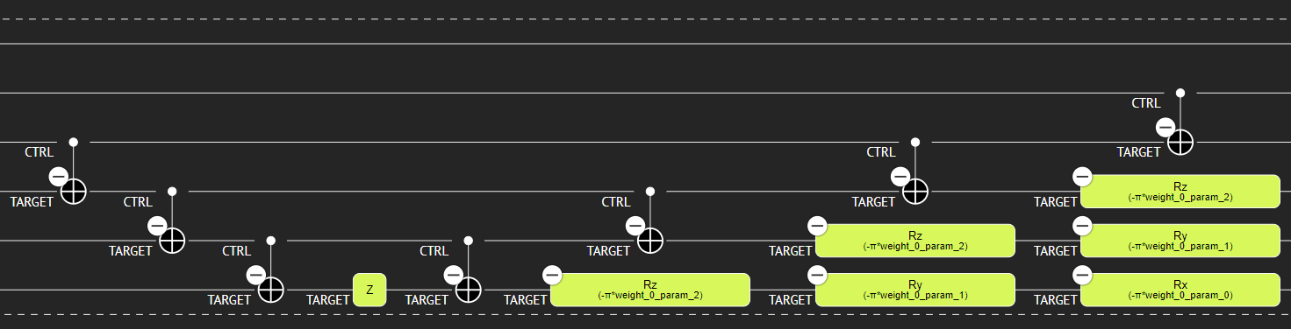
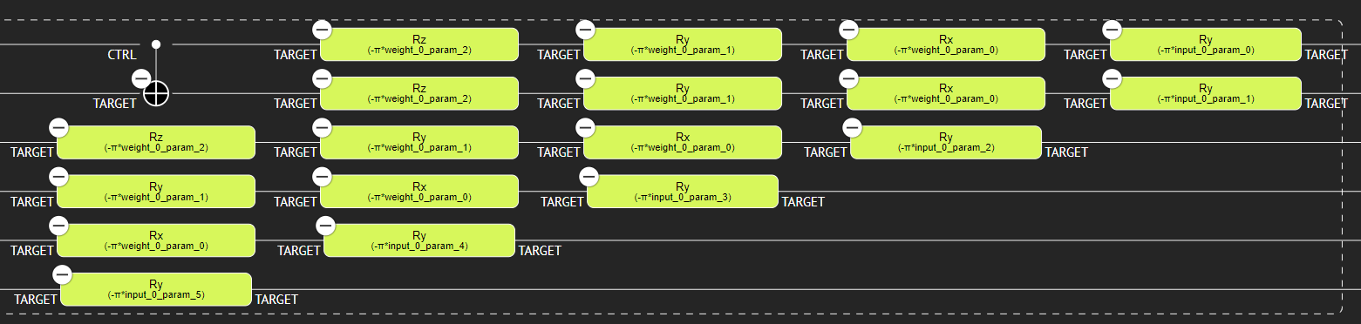
Quantum Computing Hardware
Classiq Simulator - Python SDK
Synthesises functions to quantum circuits
Access to IonQ Aria-2
UK Quantum Hackathon 2024
Notes:
Uddhav

Slide 9
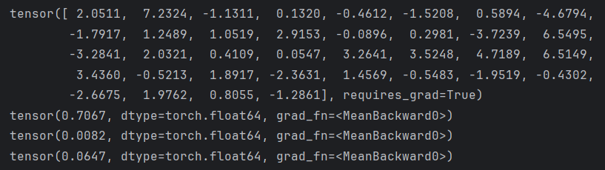
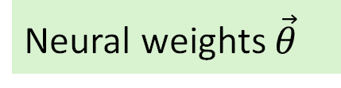
Training Iteration Results
Neural weights $\vec{θ}$
Cost values
Notes:
Freddie

Slide 10
Scaling and Feasibility
Solution is reasonably scalable compared to other methods
The circuit size scales linearly with size of input time series
Also scales linearly with number of predicted future time steps
Next steps:
Increase length of input time series
Test on more complex data e.g. Seasonal time series
Predict multiple steps in the future
The one-on-one feature to qubit embedding can also be naturally improved by using a Dressed Quantum Circuit which greatly improves scalability.
UK Quantum Hackathon 2024
Notes:
Uddhav; here we sandwich the quantum circuit by two classical layers at the beginning and the end. The main advantage is that the input and output classical bits are independent of the number of qubits in the quantum circuit.

Slide 11

Stakeholders and Impact
Solution provides a possible way of forecasting time-series with QNN
Could potentially lead to better model training
More accurate model would mean better resource allocation and preparedness
Stakeholders
Hospitals
Policy makers
Patients
UK Quantum Hackathon 2024
References:
Notes:
Mike

Slide 12
Responsible and Ethical Quantum Computing Considerations
Anticipate | Incomplete / discriminatory training data
Reflect | Continuous NHS feedback on performance and limitations
Engage | Benchmark against NHS goals
Act | Provide “grade” uncertainty rating
UK Quantum Hackathon 2024
Notes:
Frazer

Slide 13
Responsible and Ethical Quantum Computing Considerations
Societally beneficial | Correct resourcing for A&E Reducing wait times
Trusted | Between communities and healthcare providers Correct bad past experiences
Accountable | Constant reviews of the quantum computing systems Monitoring of outcomes
Transparent | Data privacy, patient confidentiality Transparency on algorithm & type of data used
Equitable | Language barriers, inclusivity, perception of cost Benefit all communities
Safe | Testing for safety and security Reviewing. Evaluating. Feedback.
UK Quantum Hackathon 2024
Notes:
Frazer

Slide 14


# show(quantum_program)
#UKQHack24
Any questions?
Team:
Ioana Mara Circu
Freddie Burns
Mentors:
Michael Spence - NHS England
Panagiotis Barkoutsos - IonQ
Nadav Ben-Ami - Classiq
Uddhav Sen
Nagwa Houmid
Tamas Vaszary
Frazer Barnsley

Slide 15
# show(quantum_program)
#UKQHack24
Any questions?
Team:
Ioana Mara Circu
Freddie Burns
Mentors:
Michael Spence - NHS England
Panagiotis Barkoutsos - IonQ
Nadav Ben-Ami - Classiq
Uddhav Sen
Nagwa Houmid
Tamas Vaszary
Frazer Barnsley
The qure to all your foreqasting woes

